Slide 1
little arduino microcontrollers
Meghan Jimenez
12 February 2014

Slide 2
 | Arduino Uno | Arduino Micro | Teensy 3.1 | Trinket
Microcontroller | ATmega328 | ATmega32u4 | MK20DX256VLH7 Cortex M-4 | ATtiny85
Operating Voltage | 5 V | 5 V | 5 V | 3.3/5 V
Digital I/O Pins | 14 | 20 | 34 | 5
PWM Channels | 6 | 7 | 12 | 3
Analog Input Channels | 6 | 12 | 21 | 3
Flash Memory -Bootloader | 32 KB – 0.5 KB | 32 KB – 4 KB | 256 KB – 0.5KB? | 8 KB – 3 KB
SRAM | 2 KB | 2.5 KB | 64 KB | 512 bytes
EEPROM | 1 KB | 1 KB | 2 KB | 512 bytes
Clock Speed | 16 MHz | 16 MHz | 2-16 MHz | 8/8-16 MHz
Footprint | 6.26 in² | 1.33 in² | 0.98 in² | 0.72 in²
Cost | $29.95 | $22.95 | $19.95 | $7.95

Slide 3
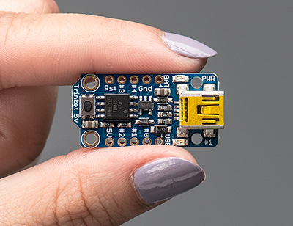
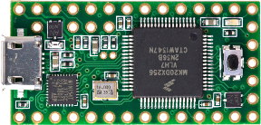
Trinket
Teensy 3.1

Slide 4
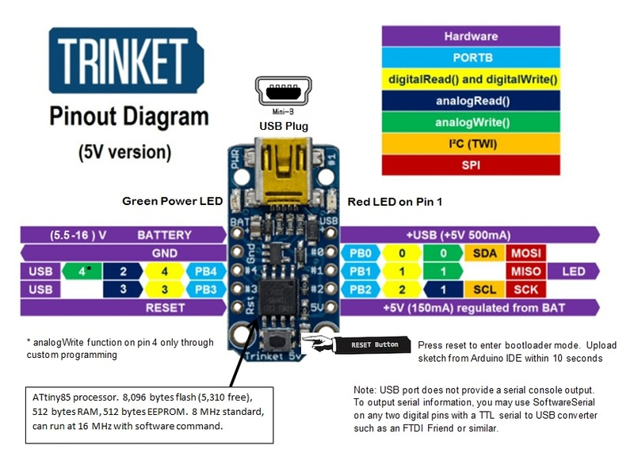
Trinket
For use in small, simple projects
Arduino IDE programmable over USB
I²C and SPI compatible
Not 100% Arduino compatible, needs some config changes to run at all
No serial port connection for debugging
Shares 2 GPIO pins with the USB interface
Recently release (Sept. 2013)

Slide 5
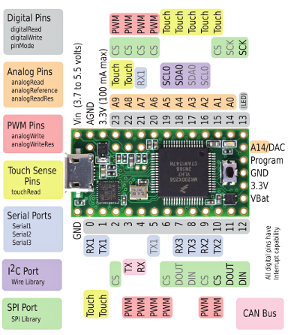
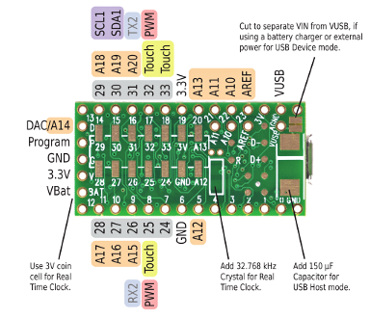
Teensy 3.1

Slide 6
Teensy 3.1
Programmable in the Arduino IDE with Teensyduino extension
All standard Arduino functions and most programs written for Arduino work
Many libraries have been tested and modified for use with Teensy and are available on the Teensy website
USB, UART, SPI, and I²C
I2S (high quality audio interface), IR modulator, 12-bit DAC, and touch sensor inputs
USB native - Emulates USB devices very easily – joystick, mouse, MIDI, etc.
Tons of memory and I/O pins
Lots of memory makes it good for graphics applications

Slide 7
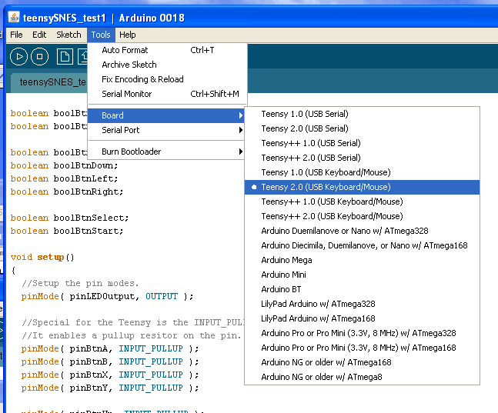
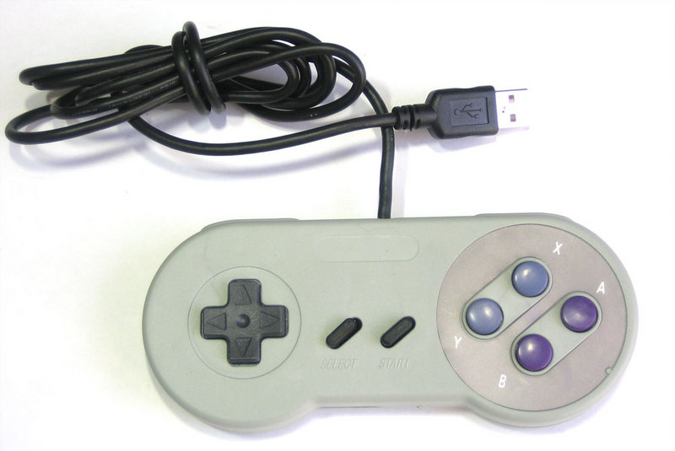
Example Teensy Project

Slide 8
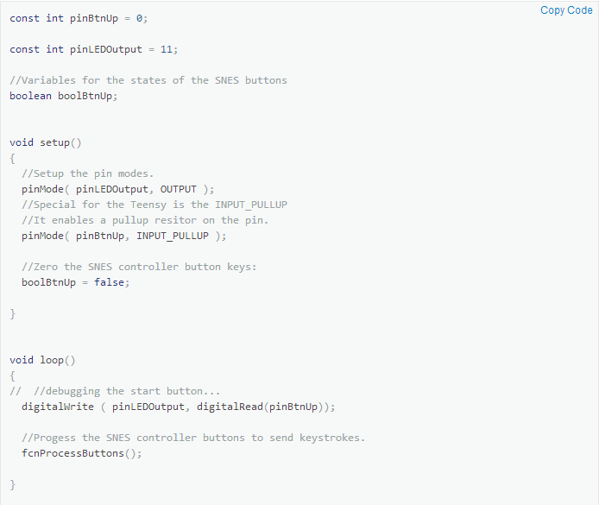
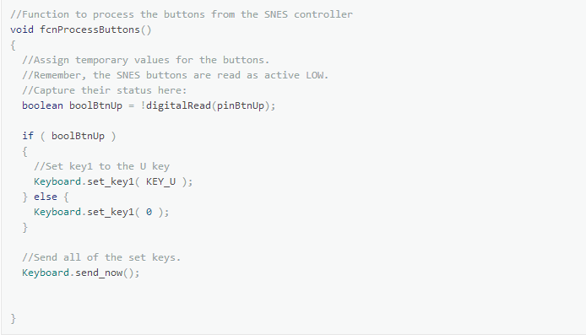
Example Teensy Project

Slide 9
References
http://learn.adafruit.com/usb-snes-gamepad?view=all
http://www.pjrc.com/
http://www.adafruit.com/

Slide 10
Any Questions?

